Slide 1

FY24 Budget Approval Meeting

Slide 2
Norms
This is a meeting of the GO Team. Only members of the team may participate in the discussion. Any members of the public present are here to quietly observe.
We will follow the agenda as noticed to the public and stay on task.
We invite and welcome contributions of every member and listen to each other.
We will respect all ideas and assume good intentions.

Slide 3
Agenda
Action Items Approval of Agenda
  Approval of Previous Minutes
  Budget Approval (after final presentation/review and discussion)
Discussion Items Presentation of the final budget
Information Items Principal’s Report
    BASC-3 Results
    Spring ACES Presentation
Announcements

Slide 4

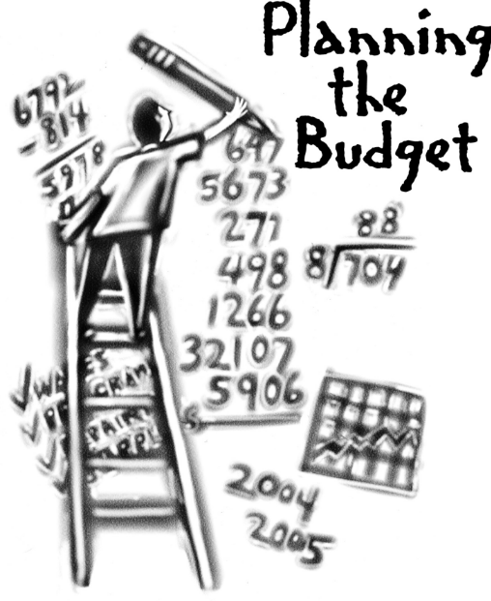
Overview of FY ‘24 GO Team Budget Process
Step 1 Review and Update Strategic Plan and Rank Strategic Priorities
By end of Fall Semester
Step 6 Principals: HR Staffing Conferences Begin
Late February – Early March
Step 3 GO Team Initial Budget Session: Allocation
January 24 – early February
Step 7 GO Team Final Budget Approval Meeting
Budgets Approved by March 17
Step 5
GO Team Feedback Session: Draft Budget Presented & Discussed
February – multiple meetings, if necessary
Step 4 Principals: Associate Supt. Discussions and Review
February (supports needed, specific challenges, coaching)
Step 2 Principals: Workshop FY 24 Budget
January 24, 2023
GO Teams are encouraged to have ongoing conversations about the school’s budget.

Slide 5
Budget Approval Meeting
What
During this meeting GO Teams will review the budget, which should be updated based on feedback from the staffing conference, Associate Superintendents, and key leaders. After review, GO Teams will need to take action (i.e., vote) on the FY24 Budget.
Why
Principals will present the final budget recommendations for GO Team approval.
When
All approval meetings must be held after staffing conferences. Budgets must be approved by March 17th.

Slide 6
Budget Review

Slide 7

FY24 Budget Parameters
FY24 School Priorities | Rationale
Improve percent of students achieving at proficient level on Milestones assessment | Provide instruction to prepare students for their next educational level and remove instructional gaps caused by Covid
Implement International Baccalaureate program model | Provide rigor and ensure our students think globally
Ensure a welcoming parent friendly environment | increase parent involvement to strengthen the partnership between school and home
Notes:
Review the priorities that the GO Team has developed and the rationale for these priorities. Feel free to copy this slide if you have more than 3 priorities to account for.

Slide 8

Staffing Conference Changes
There were not any changes made to the draft budget we discussed at our last meeting.

Slide 9
Budget by Function
*Based on Current Allocation of School Budget
School | West West Manor Elementary School
Location | 2569
Level | ES
Principal | Reginald Lawrence
Projected Enrollment | 266
Total Budget | $4,132,707
Account | Account Description | FTE | Budget | Per Pupil
1000 | Instruction | 26.05 | $2,614,474 | $9,829
2100 | Pupil Services | 3.75 | $305,936 | $1,150
2210 | Improvement of Instructional Services | 2.00 | $228,285 | $858
2213 | Instructional Staff Training | - | $- | $-
2220 | Educational Media Services | 1.00 | $106,646 | $401
2400 | School Administration | 3.00 | $377,374 | $1,419
2600 | Maintenance & Operations | 1.50 | $84,674 | $318
Notes:
I am passing out the definitions for these funding categories. You will see what makes up each category. Although the school’s total budget amount will not change, allocation per function may change depending on our conversations and school needs.

Slide 10
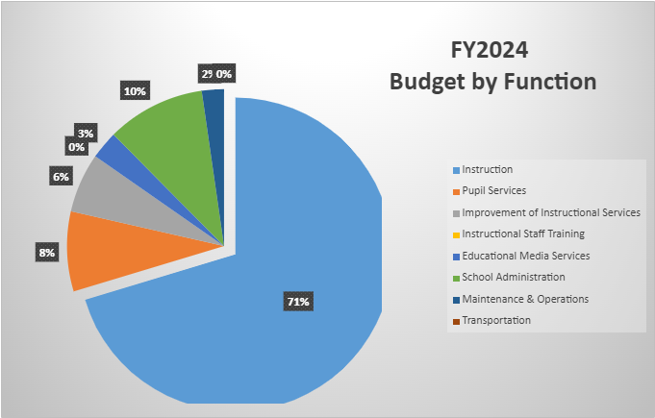
Budget by Function (Required)
*Based on Current Allocation of School Budget

Slide 11

Questions?

Slide 12
The GO Team needs to TAKE ACTION (vote) on the presented budget. After the motion and a second, the GO Team may have additional discussion. Once discussion is concluded, the GO Team will vote.
Action on the Budget

Slide 13

BASC-3 Data

Slide 15

2023 Spring ACES
NOTE to Principal: Please insert your Spring ACES presentation after this slide.
Accountability
Collaboration
Equity
Support

Slide 16

West Manor Elementary
Mays
Dr Lawrence

Slide 17
[Insert here]
0
Glow | Grow
Authorized IB School Exhibition in February 1/19 Cluster walkthrough with Peyton forrest | Need more training on toddle and rewriting of current units

Slide 18
Indicator | Time Frame
 | Fall 2022 | Spring 2023*
Attendance Take Rate | 100% | 100%
ADA Attendance Rate | 92.4% | 93.4%
Students not chronically absent | 82.7% | 79.6%
0.18**
Subgroup | Total number of students | OSS Suspension Rate
 |  | Fall 2022 | Spring 2023*
Female | 127 | 0 | 0.05
Male | 125 | 0.27 | 0.31
SWD | 18 | 0 | 0.1
Black | 212 | 0.16 | 0.21
Hispanic | 32 | 0 | 0
Multi-race | N/A | N/A | N/A
White | N/A | N/A | N/A
Asian | N/A | N/A | N/A
*As of xx/xx/2023
**A suspension rate of 1 indicates that the average student in the school (including all students, not just those ever suspended) will be suspended for one day over the course of the year. A suspension rate of 0.5 is equivalent to 50% of students suspended for one day over the course of the year.
*As of xx/xx/2022

Slide 20
Program | Avg. Daily Use (Mins) |  | Avg. Weekly Use (Days)
 | Fall 2022 | Spring 2023* | Fall 2022 | Spring 2023*
Read 180 | xx minutes | xx minutes | x days | x days
System 44 | 17.2 minutes | xx minutes | 2.4 days | x days
iRead | 27.1 minutes | xx minutes | 1.7 days | x days
*As of xx/xx/2023

Slide 21
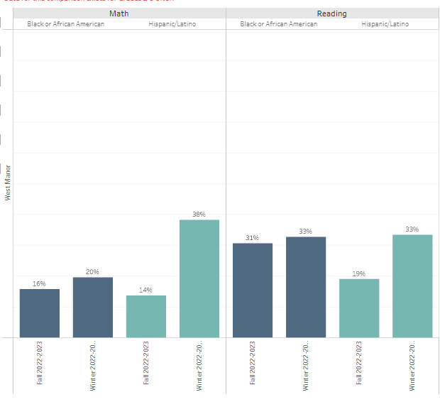
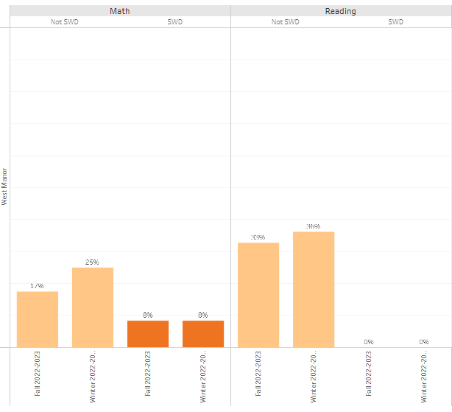

Slide 22
 | CIP Strategy | Action Step Progress Update
ELA | Implementation of intervention block from 9am to 9:45 4 times a week Focus support around the implementation of a literacy block centered around the foundations of reading -Mandatory phonics block for k-2 | Complete: artifacts: Mater Schedule, HMH Data, Observations
Math | Employ a PLC process that requires teachers to model lessons and present what students are to know and do in order to reach a level of mastery regarding the standard | Complete Artifacts: Master Schedule, Lesson presentations, PLC Schedule MTW
Whole Child & Student Support | Employ Full Time Response to Intervention (RTI) teacher to address intervention plans Creation of Attendance/ Care Team to identify and address needs of students | Complete: RTI Teacher Schedule Progress monitoring logs I Ready Individual Learning Path data Meeting agendas Decreased disciplinary infractions Improved attendance
Family Engagement | Conduct Parent meetings on Data and trainings on how to support students 3 times a year | Complete: (IB and Data meeting scheduled for February) Artifacts: Sign in sheets Agendas Annual title one meeting

Slide 24

Thank you

